Slide 1


University of South Florida St. Petersburg
Wellness Center
Student Life Center 2200
727-873-4422
stpetersburg.usf.edu/wellness
Hours of Operation
Mon - Fri, 8a-5p

Slide 2
Confidentiality
The Wellness Center staff adhere to very strict confidentiality standards. Any information provided is strictly confidential except in life threatening situations, cases of suspected child or elder abuse, or when release is otherwise required by law. Counseling and medical records are NOT part of a student's educational record.

Slide 3
Psychological Services
Services Include:
  Individual, Couples, and Group Counseling
  Psychiatric Services
  Psychological Testing
  Substance Abuse Prevention and Education
  Tele-mental Health Treatment
  Crisis Intervention
  Resources and Referrals
  Consultations for Students, Faculty, Staff, and Parents
Services are for currently enrolled USFSP students
Services are Time- and Scope-Limited
All Services are FREE and CONFIDENTIAL

Slide 4
Medical Services
Evaluation & treatment of acute illnesses and injuries
Management of chronic illnesses
Physical exams
Men’s and Women’s health services
Immunizations
Sexually transmitted infection testing
Contraception counseling/prescriptions
Registered Dietitian
Referrals to specialty care
All students with or without insurance can be seen
USF Student Health Services Insurance Office: 813-974-5407

Slide 5
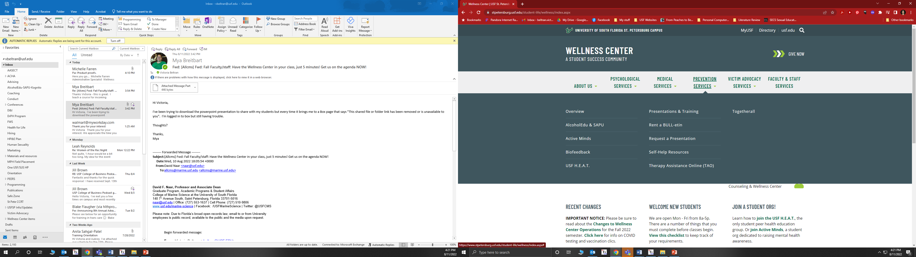
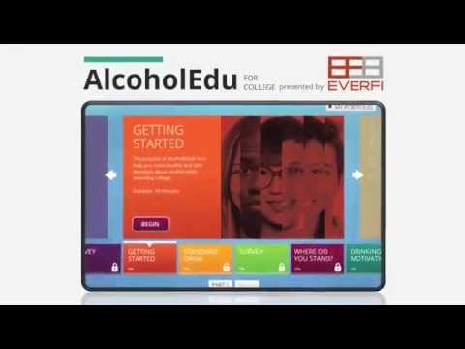

Prevention Services
    REQUIRED!
  Wellness Survey in Orientation issue REQUIRED!
Notes:
What is Health Promotion?
It’s more than just “promoting health”!
What we do is we promote, encourage, and teach students how to make healthy decisions as an adult.
AlcoholEdu for Parents: offers a consistent tone and style, providing parents with non-opinionated information, key facts, and important resources that will help them have productive conversations that can impact their student's safety, decision-making, and personal development in college.
Student Health 101: Students often cite their parents as the top 1 or 2 sources of wellness information. This magazine is short and sweet and gives you tons of information on how to talk to your child if you see any issues come up, if they’re stressed out, current college health news, and serves as a general resource for you to refer back to if you have any questions or concerns.

Slide 6

Victim Advocacy & Violence Prevention Services
Available to provide information, community referrals, support services, and crisis response to all USFSP students who may be survivors of crime (i.e., date rape, assault, domestic violence)
Services are free and confidential for all USF students
REQUIRED

Slide 7
After Hours Help
Call 727-873-4422 for after-hour consultation for medical, psychological and violence prevention/victim advocacy needs
Emergencies - Call University Police
(727) 873-4444
Check our website for all the nearby clinics and hospitals
  stpetersburg.usf.edu/wellness
  Self-Help Resources section

