Slide 1
Money Matters:
Student Financial Services and Financial Aid
How much do you owe? What funds are coming in?

Slide 2
Student Financial Services -
What is Owed
Note: This information is provided in Pre-Orientation Videos

Slide 3
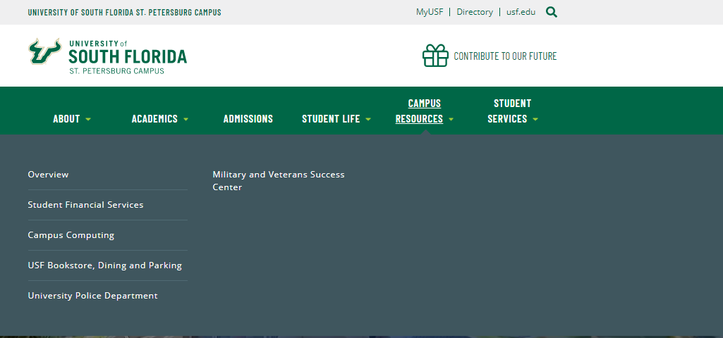
Webpage: Where to find information -
Student Financial Services and Parking
www.stpetersburg.usf.edu

Slide 4
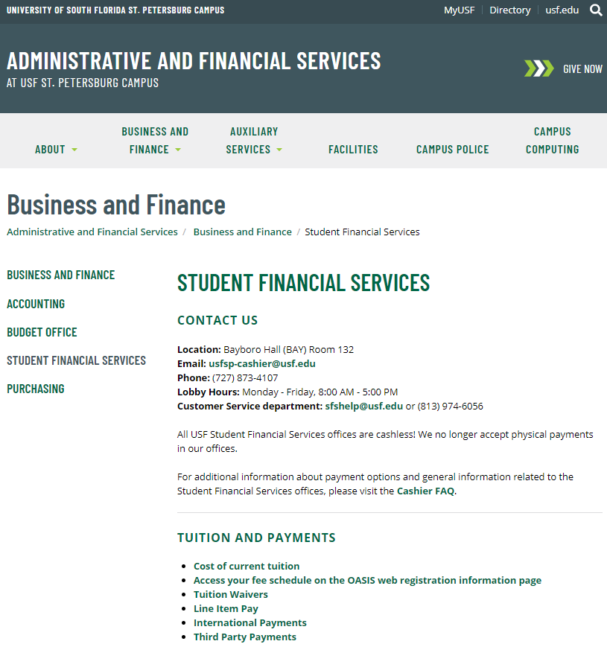
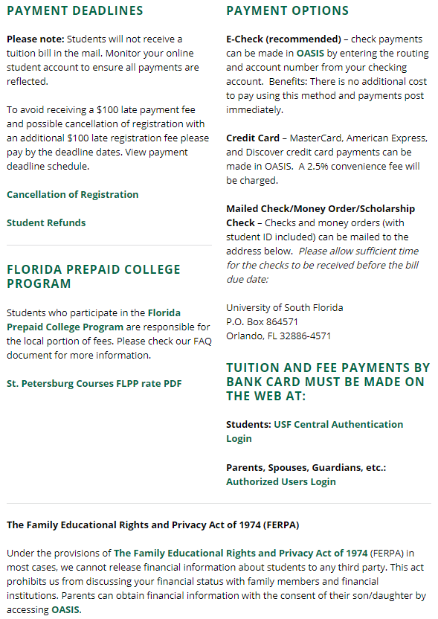
Webpage: Student Financial Services

Slide 5
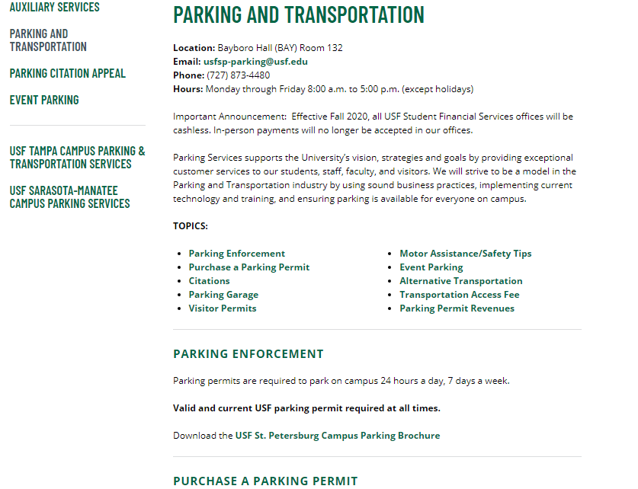
Main webpage > Campus Resources> USF Bookstore, Dining and Parking
Parking Services

Slide 6
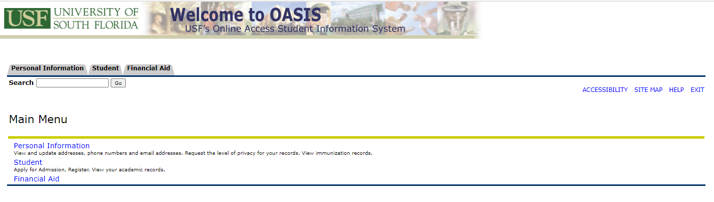
Student tab
MyUSF > My Resources > OASIS > Student tab
View your charges
Pay your bill
See pending aid to be paid
Subscribe to e-deposit
Check your Class Schedule
Purchase your textbooks

Slide 7
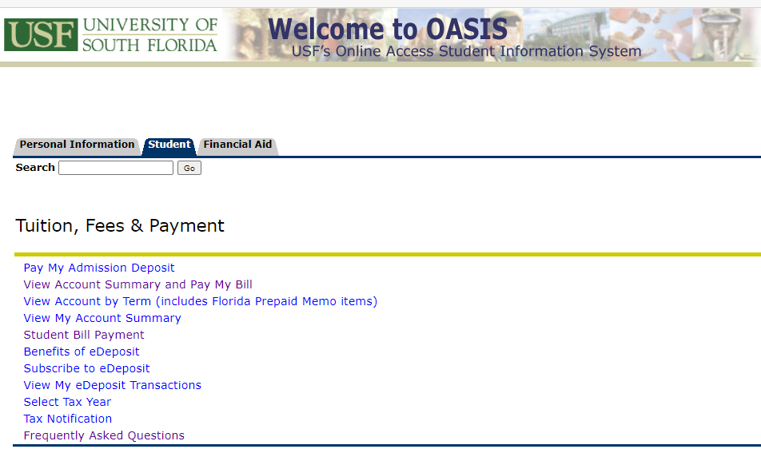
OASIS – Student
“View Account by Term”
Before the end of drop/add week:
  Total Charges Due
  Pending Financial Aid (listed as “Authorized Aid”)
  Pending Florida Pre-paid (listed as “Memo Balance”)
  Note: if not receiving any aid, charges need to be paid by the end of the first week of every semester!
After drop/add week:
  Remaining charges due
  Prepaid pays 30 days into the semester
Get your Refund FASTER – sign up for e-Deposit!

Slide 8
Financial Aid
What is Coming In!

Slide 9
Financial Aid
FAFSA (Free Application for Federal Student Aid) – only application used by USF to determine federal, state, and institutional financial aid
Verification: The federal government requires the school to verify or confirm the data reported by students and their parent(s) on the FAFSA. About 30% of students are selected. Until this process is finished, a student will not received a financial aid award.
OASIS – personal USF Student Account information (financial aid tab)
Deferments – postpones “when” payments are due. It also prevents cancellation of registration for non-payment of fees.
Bookstore Advance Purchase Program (BAPP): Allows financial aid students to “charge” books against their incoming financial aid. Amount of purchases is charged to the student account. When financial aid pays, it takes care of the charge. Eligible students will be sent an email notification.
EFC/Cost of Attendance (OASIS:Financial Aid) versus “Real Charges” (OASIS:Student)
Financial Aid Awards (Award Package)
Terms and Conditions: Outlines the requirements you must meet in order to remain eligible for financial aid. Before grant, loan or work study funds can be paid, you are required to READ and ACCEPT the Terms and Conditions in OASIS every year. Some scholarships have separate Terms and Conditions.
USF Priority Deadline – Students that have their FAFSA processed by January 1st are considered for additional federal, state, and institutional grants as well as work study!

Slide 10
Financial Aid – Information to Know
When do you start? | Complete the following FAFSA(s) | Uses this tax year information
Fall 21 | 2122 FAFSA | 2019 taxes
Summer 21 | BOTH 2021 & 2122 FAFSA’s | 2021 uses 2018 taxes, and 2122 uses 2019 taxes
The types of aid you receive are based on:
Grants: Based on financial need. Do not need to pay back. Pell Grant is an entitlement. Other grants are based on meeting the USF priority deadline.
Federal Work Study: Based on Financial need and meeting the priority deadline. Student must indicate on the FAFSA that they have an interest in student employment.
Loans: Both need- and non-need based, maximum eligibility offered for student loans based on grade level and dependency
Scholarships: Admissions scholarships are automatically awarded, if eligible. Financial Aid scholarship application opens in November every year (www.usf.edu/scholarships)
  If awarded, make sure to complete your Terms and Conditions and Thank you letters, if required.
Plan for Next year (2223)
2223 FAFSA (Fall 2022, Spring 2023, Summer 2022): Apply between October 1 – December 31, 2021 for maximum eligibility and to beat the USF Priority FAFSA deadline of January 1st!!
Beginning this Summer 2021?
Both FAFSA’s
Bright Futures?
  Add USF under your Demographic information on the Bright Futures webpage.
  State of Florida updates by July 1st!

Slide 11
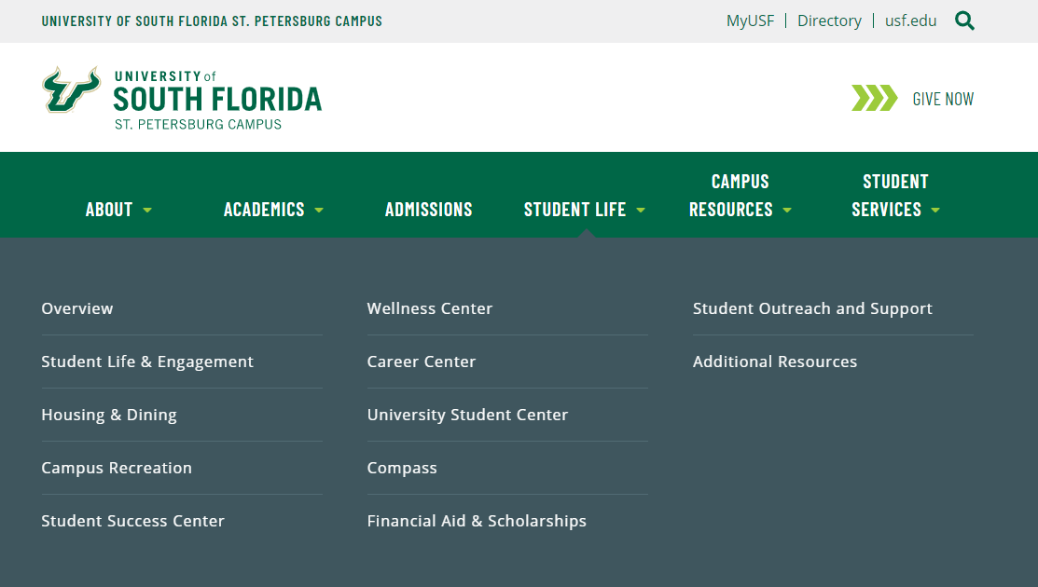
Webpage: Financial Aid
www.stpetersburg.usf.edu

Slide 12
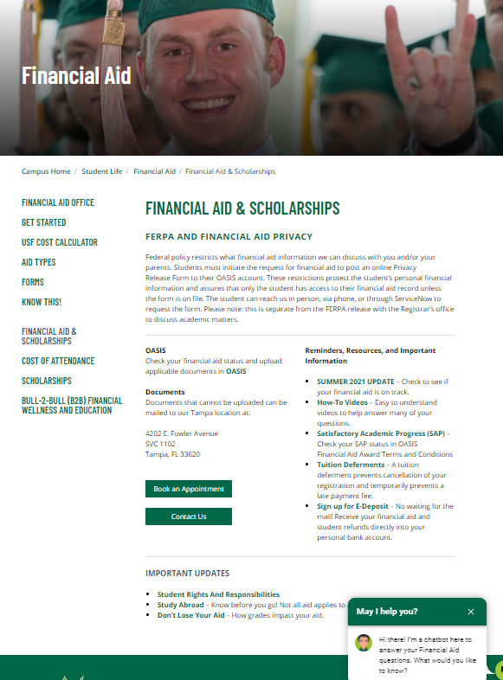
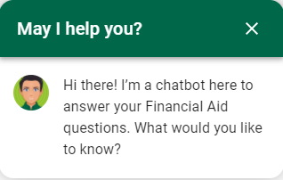
Webpage:
www.stpetersburg.usf.edu/finaid

Slide 13
FERPA – Confidentiality and Privacy of Records
Due to federal regulations regarding the security of financial aid data, we are only able to provide the student with detailed information about their financial aid
If you are the parent listed on the FAFSA (biological or adoptive), your student may complete the Online Privacy Release for Dependent Students form to authorize you to receive limited financial aid information
Additional authentication questions to confirm your identity will be asked during each contact with our office
Other university offices have separate authorization requirements

Slide 14
Financial Aid tab
MyUSF > My Resources > OASIS > Financial Aid tab
Know which aid year: 2021 or 2122? (Fall, Spring, Summer)
What documents are needed
Eligible for a Deferment – postpones due date
Eligible for a BAPP – Bookstore Advance Purchase Program
See pending aid to be paid
  General Information tab
List any non-USF scholarships
Accept your Terms and Conditions for Scholarships and for Financial Aid
See Cumulative Loan Totals

Slide 15
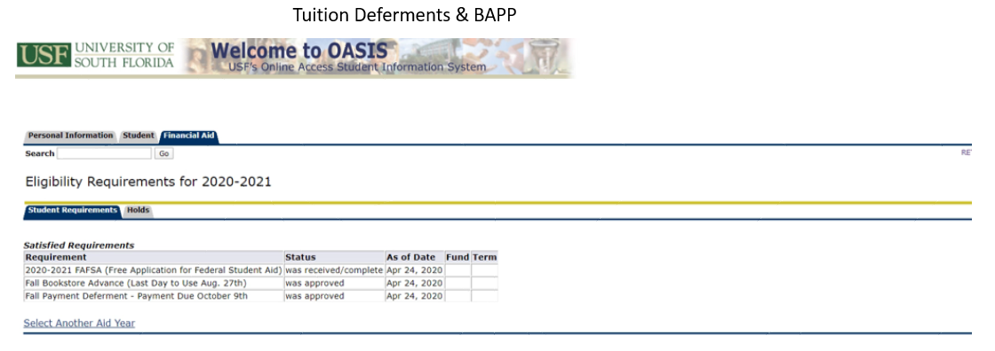
Financial Aid –
My Requirements, Bookstore Authorizations and Deferments
My Requirements, Bookstore Authorizations and Deferments
FAFSA received
Documents needed to complete Financial Aid file
Deferment posted if:
  Enrolled at least half-time (6 undergraduate credit hours)
  In “Good” Satisfactory Academic Progress AND at least one of the following:
    FAFSA is on file
    Bright Futures certified from the state
    USF Scholarships
    Outside scholarships that we know about
    Florida Prepaid (note: if student is ONLY receiving FPP, they receive the same length of time to pay any remaining balance due, but a deferment will not show up in OASIS.
Eligible for a BAPP – Bookstore Advance Purchase Program
  Automatically provided if student has at least $100 more in Financial Aid that the charges under “Tuition and Fees”.

Slide 16
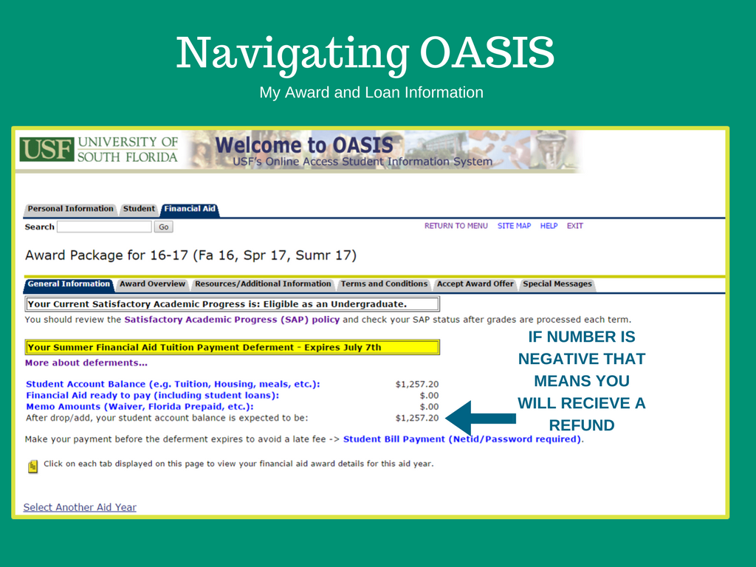
Financial Aid – My Award and Loan Information
My Award and Loan Information
General Information tab
  Satisfactory Academic Progress status.
  Overview of total amount due, pending financial aid, and pending Florida Pre-paid.
  Will show anticipated refund or remaining amount due.

Slide 17
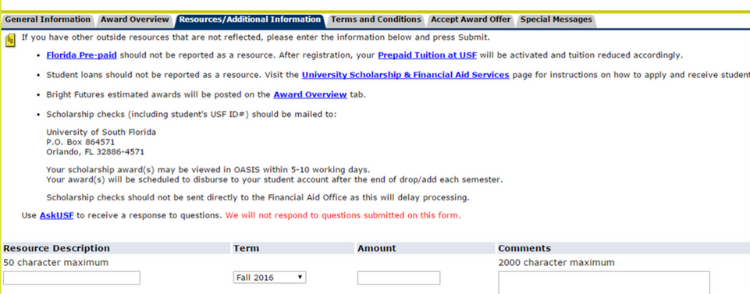
Financial Aid – My Award and Loan Information
My Award and Loan Information
Resources/Additional Information
  List any non-USF scholarships you receive

Slide 18
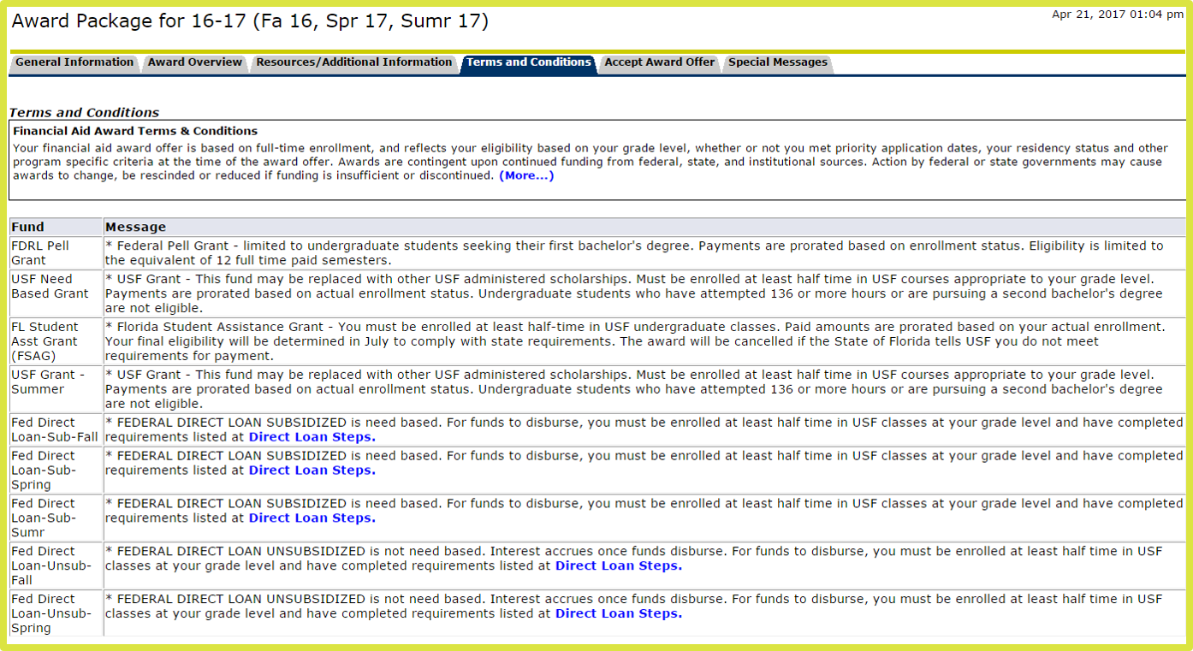
Financial Aid – My Award and Loan Information
My Award and Loan Information
Terms and Conditions (T&C’s)
  Only means that you understand the rules and regulations of getting any aid offered – not that you are accepting it!
  May have separate Scholarship and Financial Aid T&C’s

Slide 19
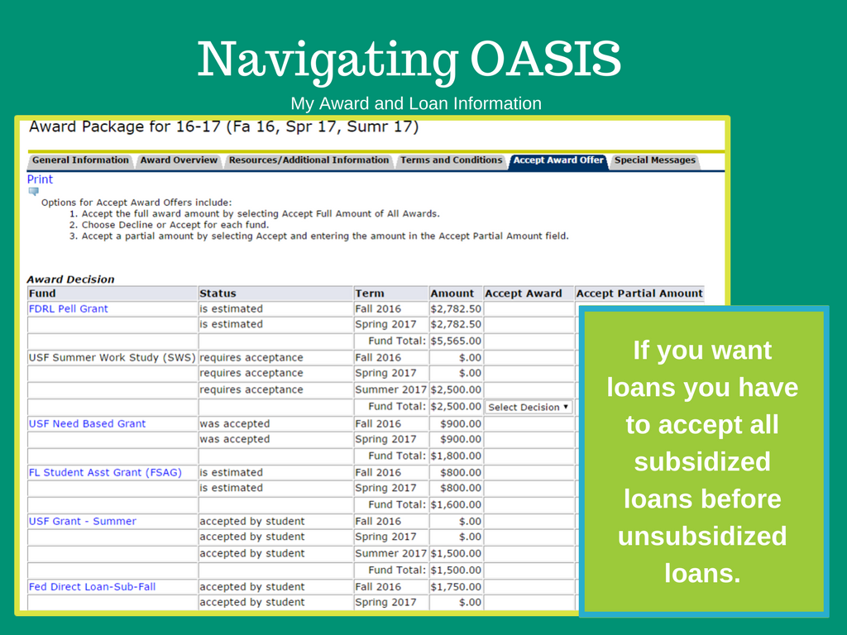
Financial Aid – My Award and Loan Information
My Award and Loan Information
Accept Award Offer
  Grants and Scholarships are automatically accepted
  Loans and Federal Workstudy require acceptance
  Can accept a partial loan amount.

Slide 20
Financial Aid Payments
Financial aid and Bright Futures is paid on the seventh day of the term after your enrollment is confirmed. The first week is considered drop/add week. (Note: Florida Pre-paid applies about 30 days into the semester)
Your bill is paid using available financial aid in the following order:
  Tuition & fees
  Housing (if on campus)
  Meal Plan
  Bookstore (if the BAPP was used)
If the bill is paid in full and a credit results, remaining funds are sent to your bank account if you subscribed to e-Deposit in OASIS during the second week of classes
If the bill is not paid in full, you will have until the Deferment date in OASIS to pay the remainder.

Slide 21
Summary
Read Your Email—All emails are sent to the your USF email address
FAFSA: https://studentaid.gov/
  Complete the 2020-2021 FAFSA for Summer 2021
  Complete the 2021-2022 FAFSA for fall 2021, spring 2022, & summer 2022
OASIS: Complete any unsatisfied financial aid requirements in OASIS
  Terms & Conditions: Read and accept in OASIS
  Accept Award Offers: Loans and Work Study require acceptance
  Loans: Students must complete the online Master Promissory Note & online Entrance Counseling if loans are accepted at https://studentaid.gov/

Slide 22
First Time in College Student Summary
Complete the 2021 and 2122 FAFSA if you are admitted for Summer.
Add USF under your demographic information on the Bright Futures webpage.
Read the emails going to your USF email account!
Remember that your “real costs” are charged in the Student tab of OASIS, and not listed as your Cost of Attendance in your Award screen.
If you do NOT have a FAFSA, Bright Futures, Florida Prepaid Tuition, or Scholarships – you MUST pay your charges by the end of the first week of classes or risk being dropped for non-payment.

Slide 23
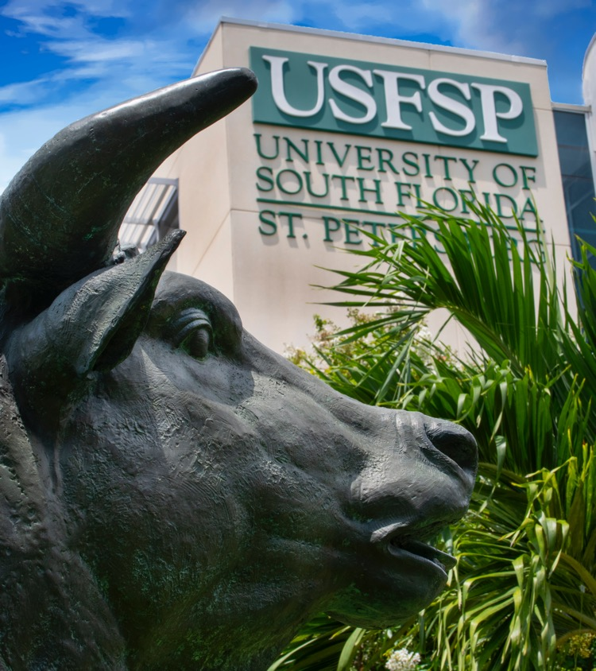
Thank you!
Still have questions?
Please reach out to us through the “Contact Us” section of the Financial Aid webpage.

