Slide 1

Safety Education
UNIVERSITY POLICE
Chief David Hendry

Slide 2
Overview
USF Police Department (UPD) is a professional state accredited law enforcement agency serving and protecting the university community.
UPD officers patrol the campus and surrounding areas 24 hours a day, 7 days a week.
We strive to provide a safe campus community and to serve as a resource to campus members.
UPD is located at 530 3rd St South on the first level of the parking garage.

Slide 3
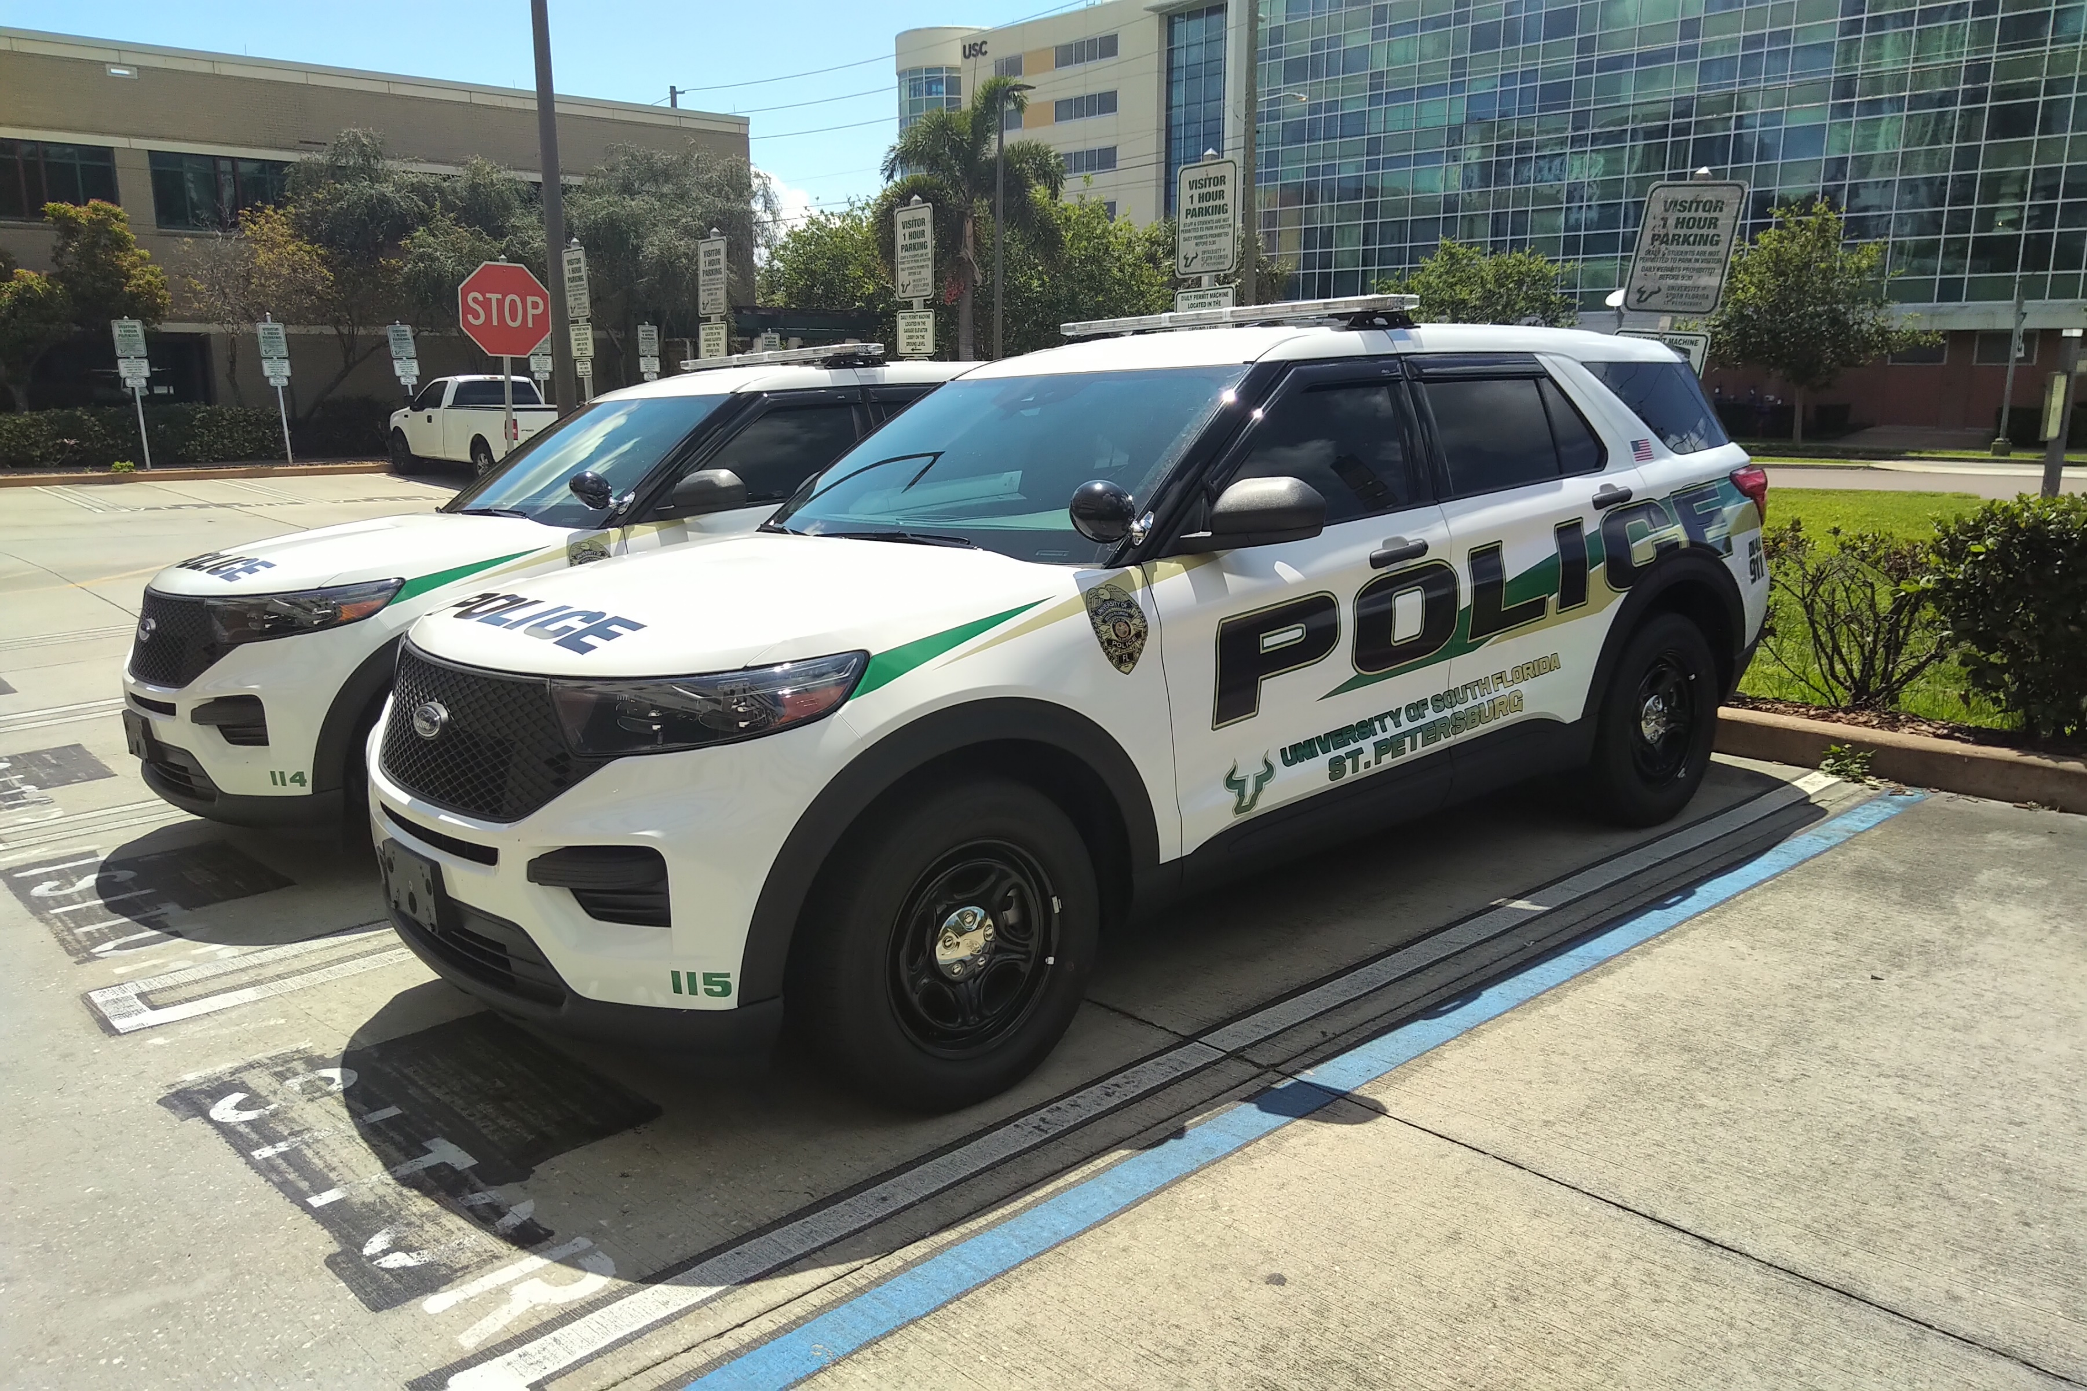
University Police
UPD provides traditional police services, such as…
Responding to campus emergencies
Investigating criminal incidents and traffic crashes
Enforcing traffic laws and pedestrian safety
But we also can be called upon for so much more…
Assist victims with resources
Help students who may need assistance
Provide escorts at night to their vehicles
Provide safety programs, such as Defend-a-Bull, Armed Intruder Training and Bicycle registrations

Slide 4
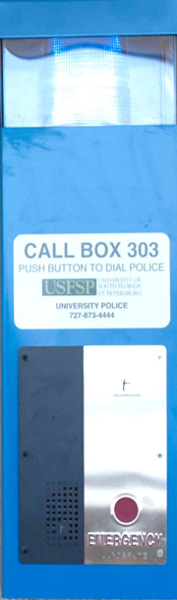
How to Summon Assistance
Blue light emergency phones
Dial 727-873-4444 from any university phone
Dial 911
We will need to know your location and problem
Your Cellular Contact List
  Do you have your cell phone programmed with the number for the University Police
  “Police USFSP 727-873-4444”

Slide 5
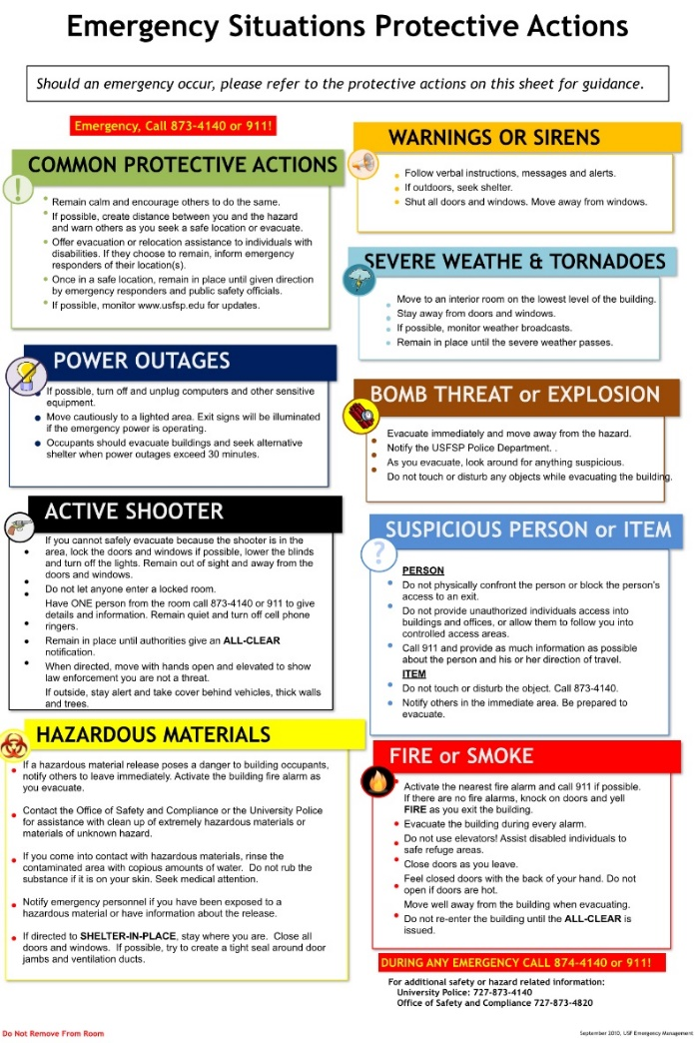
In Case of Emergency
Follow campus emergency procedures and evacuation maps posted on campus.
Monitor campus website for emergency information.
And, be sure that you are subscribed to the emergency notification system for the SP campus.

Slide 6

Emergency Notification System
Alert USF was established to notify our campus community in the event of an emergency.
The service is free; however, standard text messaging rates may apply.
Subscribe at https://www.stpetersburg.usf.edu/police/

Slide 7
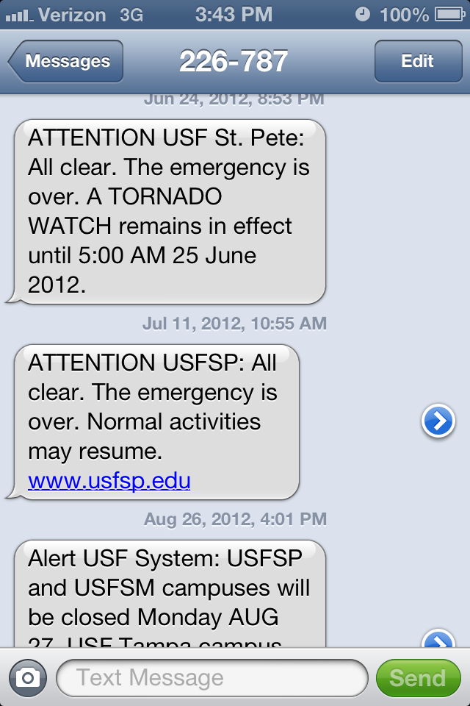
Emergency Notification System
Alert USF messages will be sent to subscribers when on-going incidents may threaten the campus community.
Alert USF messages include…
Cellular text messages
University webpage
Facebook
X
Outdoor speakers

Slide 8
Emergency Notification System
Alert USF Overview:
Verify which campus has issued the alert.
View https://www.stpetersburg.usf.edu/police/ for the most current information to avoid the need to call the police during emergencies.
Emergency Notification Alerts are issued for on-going threats to the campus, which might include weather conditions or emergency situations.
We also will provide timely notifications of criminal incidents or other concerns by e-mail messages to your USF email account.

Slide 9
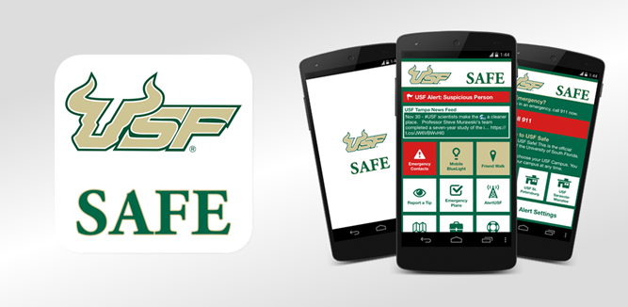
USF SAFE smart app
Mobile Blue Light feature
Friend Walk and Location Sharing
Emergency Call Button
Emergency Action Protocols

Slide 10
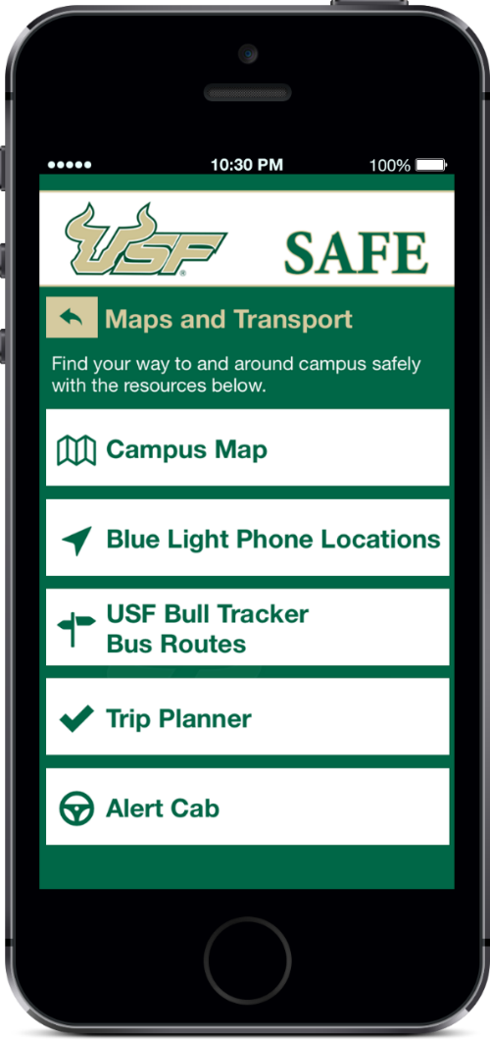
USF SAFE
Interactive mapping
Campus Maps
Blue Light Locations
Trip Planner on campus
Crime Tip Reporting

Slide 11
USF SAFE
Subscription updates are easily accessible via the UPD webpage at https://www.stpetersburg.usf.edu/police/

Slide 12
General Safety Messages
Pedestrian safety…always look both ways before crossing the street
Traffic safety…always observe stop signs and posted speed limits, drive carefully
Personal safety…always think safety! Don’t walk alone at night, watch your surroundings, trust your instincts and protect yourself
Personal Belongings…be responsible, don’t leave items unattended, and always lock cars and bikes

Slide 13
General Safety Messages
While there is very little misconduct reported on campus, we always encourage you to …
Be Alert to your surroundings
Exercise good judgment
Keep your belongings safe
Report suspicious persons and incidents
Be equally as alert when you are On-line and with Social Media
Know that you can call the Police for any assistance or information regarding helpful resources

Slide 14

Educational Safety Programs
Bicycle Safety and Security
Orientation
Office Safety and Security
Personal Safety
Residence Hall Safety
Theft Prevention
Defend-a-Bull Program
If you are interested in an upcoming course please let us know.

Slide 15
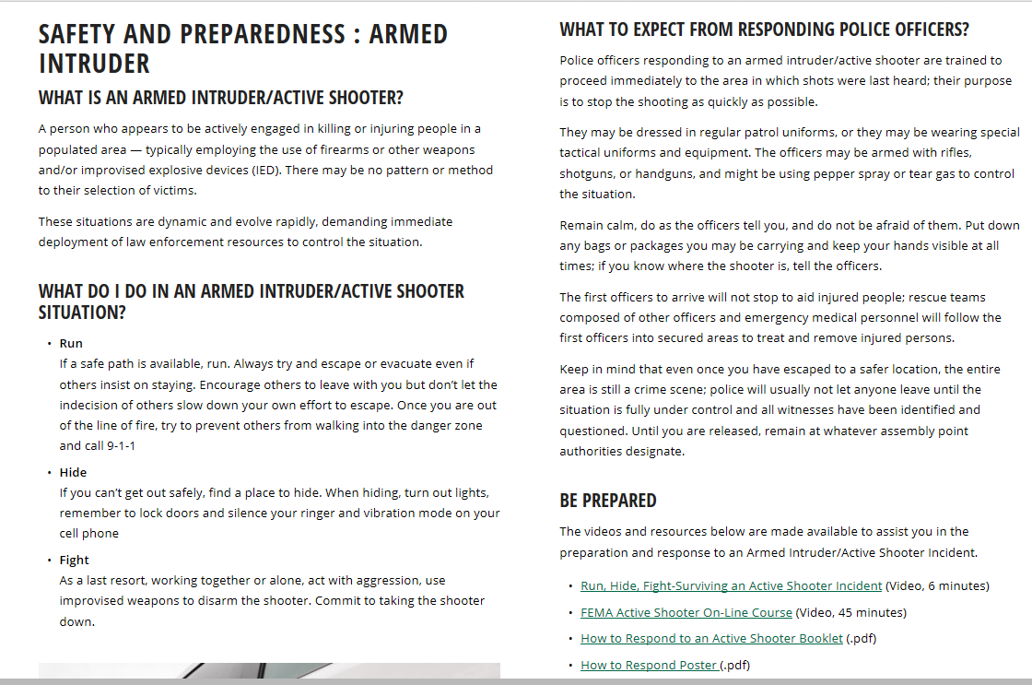

Armed Intruder

Slide 16
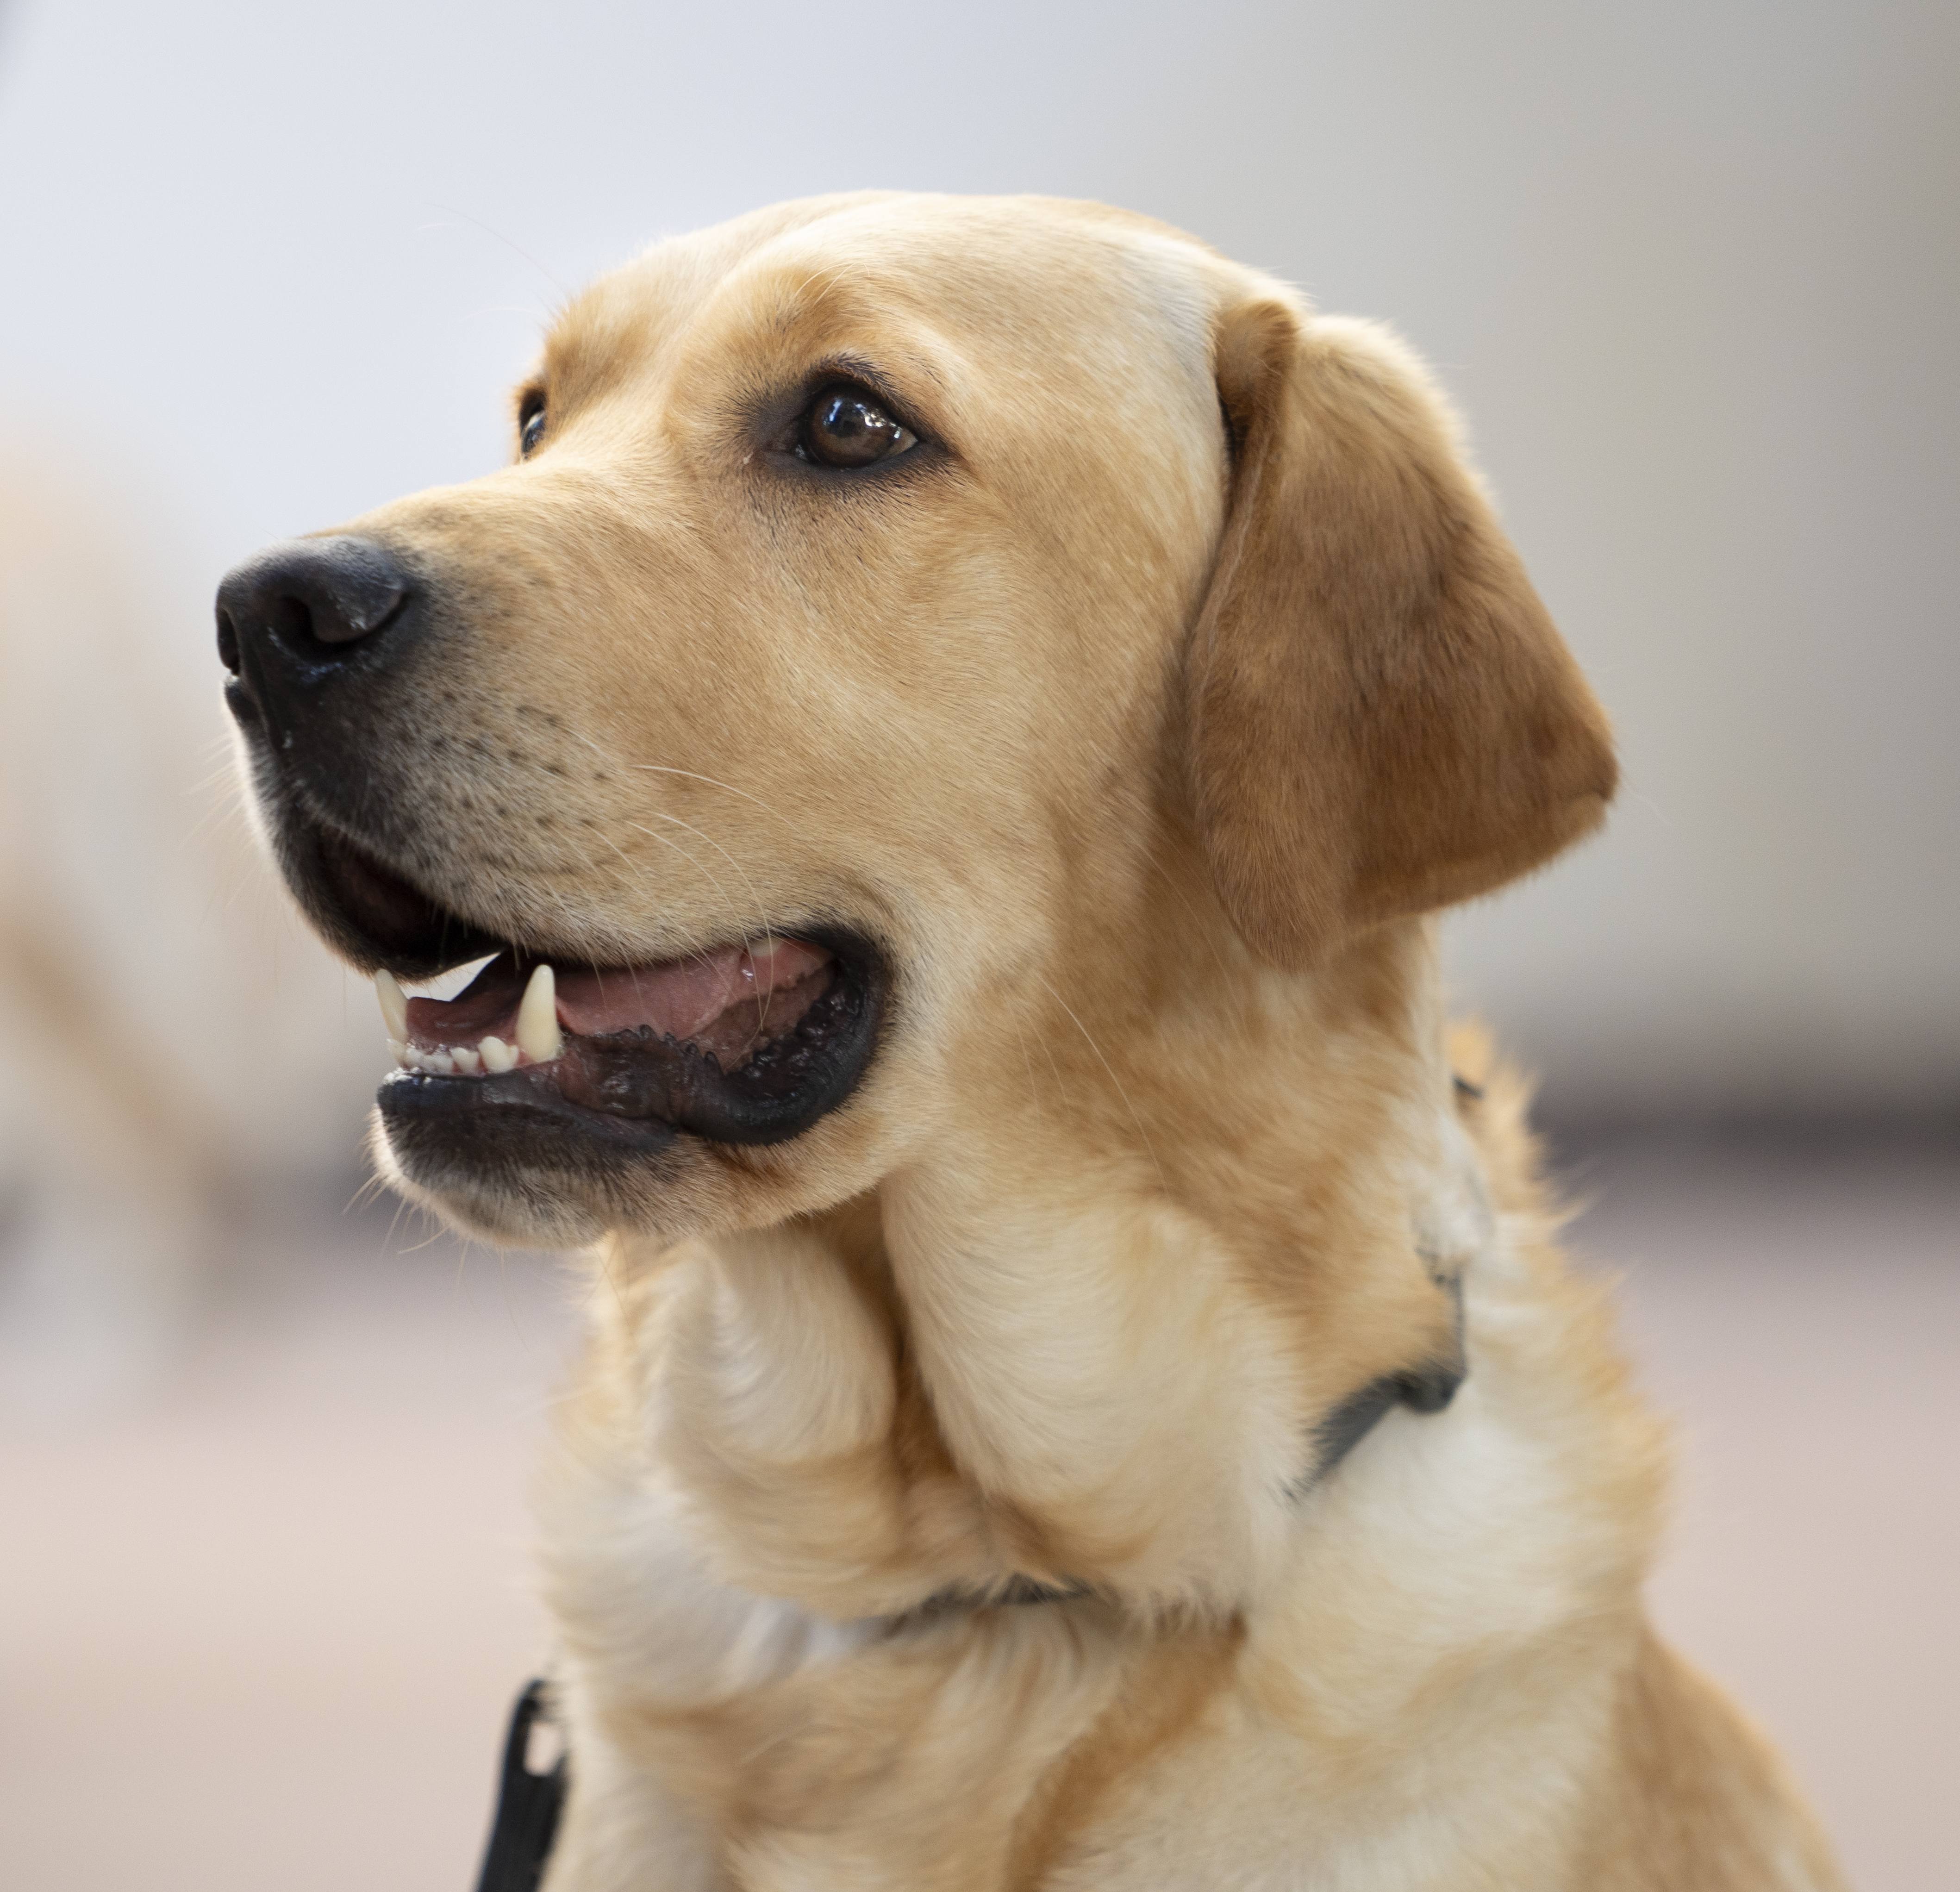
UPD Website
Great source for information and resources:
Armed Intruder Training (videos and documents)
Annual Security Report (Clery Act Crime and Fire Safety Info.)
FDLE Sexual Offender/Predator Offender Search (www.offender.fdle.state.fl.us/offender and 1-888-357-7332 )
Alert USF Emergency Notification Sign-Up
Crime Prevention/Safety Tips
Weather/Emergency Preparedness
Other Helpful Resources
https://www.stpetersburg.usf.edu/police/

Slide 17

Reporting Suspicious Activities
If you see or become aware of any suspicious behavior or conduct, REPORT IT, you may prevent a tragedy.
This may include concerning behaviors or comments or posts on social media sites.
Call the University Police or if you wish to be anonymous, utilize Silent Witness at the UPD website.

Slide 18
Reporting a Crime
To report a crime on campus contact the University Police at 727-873-4444. If the crime occurred off campus, UPD will assist you in contacting the appropriate police agency.
The Public Safety Operator will ask for additional information and send a police officer to assist you.
Always take steps to preserve evidence, which is very important in many incidents, such as domestic, dating or sexual assaults, stalking, property crimes, etc.
The police officer will provide additional information such as crime victim resources, injunction information and other helpful services.

Slide 19
Supporting Resources
If you find yourself or a friend in a difficult or troubling situation, you may be looking for somewhere to turn for assistance
You should know that the university offers a wide range of services on campus and in our area to help.
Contact the University Police, Wellness Center or a Campus Security Authority for assistance or follow-up on our websites for additional information.
…mental well-being, domestic troubles, sexual assault, stalking, bullying, harassment, violence, etc…

Slide 20
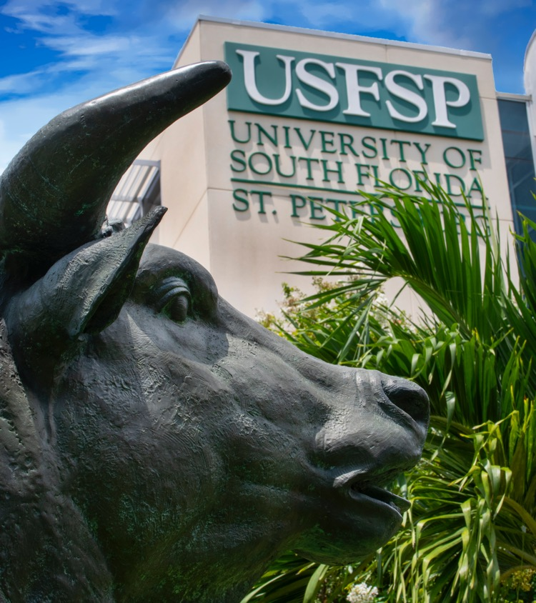
Questions?
UPD
727-873-4444 https://www.stpetersburg.usf.edu/police/

